Slide 1
What Are Problem Behaviours ? ● Why do they occur? ● How Can We Solve This ? ● Here are some tips!
Behaviour Management
Problem Behaviours!
Walk your child through replacing challenging behaviours with desirable behaviour!

Slide 2
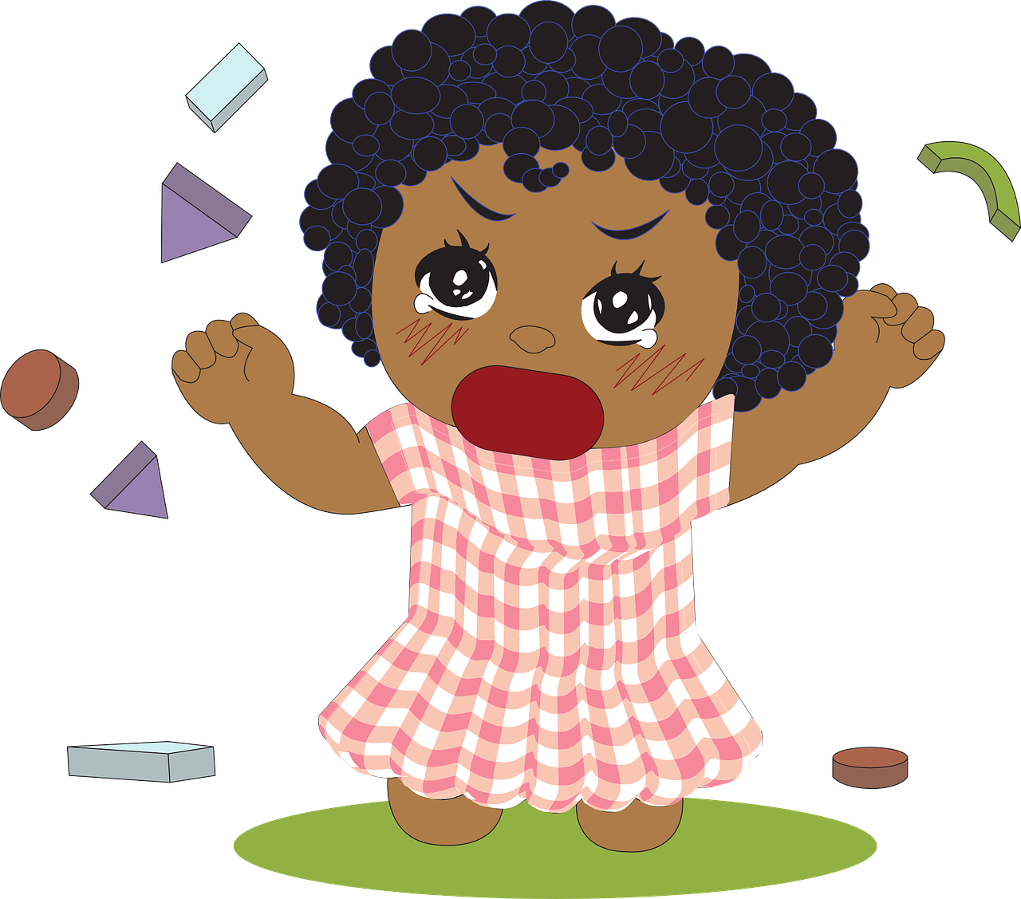
What Are Problem Behaviours ? ● Why do they occur? ● How Can We Solve This ? ● Here are some tips!
What Are Problem Behaviours?
Problem (or challenging) behaviours
are behaviours of such intensity,
frequency, or duration that they may
affect the physical safety of the
actor or others around.
In simpler terms, it's anything that your child
does often + that is unsafe for them or others.

Slide 3
What Are Problem Behaviours ? ● Why do they occur? ● How Can We Solve This ? ● Here are some tips!
What Are Problem Behaviours?
These behaviours may interfere &
limit your child's learning of skills.
The behaviours are likely to be
deviant & inappropriate for
your child's age.
These may cause unreasonable stress
to everyone around.

Slide 4
What Are Problem Behaviours ? ● Why do they occur? ● How Can We Solve This ? ● Here are some tips!
Examples of
Problem Behaviour
Being stubborn or non-compliant
Agressive behaviours like pushing, hitting, throwing objects, biting, pinching, pulling hair, etc
Hyperactivity & poor attention
Self-harming like scratching, hair-pulling, head-banging, etc
Repetitive behaviours like rocking, hand-flapping, etc.
Do not forget to praise your child
during the learning process.

Slide 5
What Are Problem Behaviours ? ● Why do they occur? ● How Can We Solve This ? ● Here are some tips!
Finding The Cause
Problem behaviours occur for a reason.
They serve a purpose for your child.
The best way to understand the purpose
is observe the challenging behaviours:
Time of day,
Duration,
Intensity,
Trigger/s, &
Consequence/s.
Look out for reinforcers!
Behaviours will recur when rewarded!
Do not forget to praise your child
during the learning process.

Slide 6
What Are Problem Behaviours ? ● Why do they occur? ● How Can We Solve This ? ● Here are some tips!
Causes of Problem Behaviours
Attention Seeking
Is the problem behaviour occuring mostly when you're not paying attention to your child?
Does the behaviour cease the moment you give attention to your child?
In such scenarios, the more attention you give to the
behaviour, the more likely that your child repeats it.
Do not forget to praise your child
during the learning process.

Slide 7
What Are Problem Behaviours ? ● Why do they occur? ● How Can We Solve This ? ● Here are some tips!
Causes of Problem Behaviours
Other Conditionings
If your child throws a tantrum and you fulfill their need immediately, they learn that throwing tantrums works.
This need could be food, toys, or anything else.
Pampering or inconsistent disciplinary methods may add to this.
In such scenarios, the more you reward
your child's tantrums, the more likely
that they repeat the problem behaviour.
Do not forget to praise your child
during the learning process.

Slide 8
What Are Problem Behaviours ? ● Why do they occur? ● How Can We Solve This ? ● Here are some tips!
Causes of Problem Behaviours
Escaping Uncomfortable Situations
Does the behaviour occur the most when your child is trying to get away from an uncomfortable situation / person / activity?
For eg: Your child doesn't like their uncle. Each time the uncle comes home, your child throws a tantrum. You take your child to a separate room. Your child stops throwing the tantrum.
A tantrum may be your child's way
of saying that they feel unsafe.
Do not forget to praise your child
during the learning process.

Slide 9
What Are Problem Behaviours ? ● Why do they occur? ● How Can We Solve This ? ● Here are some tips!
Causes of Problem Behaviours
Medical Conditions
Your child may not be able to communicate feelings like pain, hunger, thirst, etc. This is especially true if they have delayed speech development / are non-verbal.
Once the bodily need that caused palpabale pain is taken care of, your child will cease to act out.
A tantrum may be your child's way
of saying that they feel pain.
Do not forget to praise your child
during the learning process.

Slide 10
What Are Problem Behaviours ? ● Why do they occur? ● How Can We Solve This ? ● Here are some tips!
Causes of Problem Behaviours
Neurological Conditions
Due to their disability, your child may have poor comprehension, cognition, &/or problem-solving abilities.
If your child doesn't understand the challenge / situation before them, they may act out.
Sometimes, there may be a simpler explaination -- plain boredom.
Your child may not understand
their own problem behaviours.
Do not forget to praise your child
during the learning process.

Slide 11
What Are Problem Behaviours ? ● Why do they occur? ● How Can We Solve This ? ● Here are some tips!
How Can We Solve This?
Change the Environment / Situation
For example, if your child is distracted or fidgety, remove distracting objects from their vicinity while taking them through a structured session of constructive activities.
Engage your child in only one activity at a time!
Do not forget to praise your child
during the learning process.

Slide 12
What Are Problem Behaviours ? ● Why do they occur? ● How Can We Solve This ? ● Here are some tips!
How Can We Solve This?
Increase Their Attention Span
Keep prompting your child for every step of their task. Remind them to focus.
Before moving to new or difficult tasks, always begin with a simple activity to boost your child's enthusiasm.
Increase the difficulty of the task gradually.
This is a more long-term conditioning for
your child's general attention span!
Do not forget to praise your child
during the learning process.

Slide 13
What Are Problem Behaviours ? ● Why do they occur? ● How Can We Solve This ? ● Here are some tips!
How Can We Solve This?
Positive Reinforcement — Give Encouragement
Reinforcement is used to
teach new behaviours, which should be followed immediately after a desired action/behavior.
increase your child's motivation to perform desired behaviors repeatedly.
Encouraging the child goes a long way
For e.g. If potty training your child, give them a high-five for each time they flush independently.
Do not forget to praise your child
during the learning process.

Slide 14
What Are Problem Behaviours ? ● Why do they occur? ● How Can We Solve This ? ● Here are some tips!
How Can We Solve This?
Positive Reinforcement — Give Encouragement
You could give them an object that they like/activity that they like to do, when they behave appropriately.
Verbal praises such as 'Good job!' or 'Well done !' for the particular task can go a long way.
If your child appreciates physical affection, a high-five or a hug also helps.
Encourage at every successful attempt!
Appreciation will motivate your child to repeat
the behaviour.
Do not forget to praise your child
during the learning process.

Slide 15
What Are Problem Behaviours ? ● Why do they occur? ● How Can We Solve This ? ● Here are some tips!
How Can We Solve This?
Functional Communication
Sometimes, your child may be acting out as a way of asking for something.
In such situations, teach them a way to communicate the same need with a word or gesture.
For eg, ask them to raise their hand or point at a picture when wanting to convey something. This will take multiple practices to learn.
Do not forget to praise your child
during the learning process.

Slide 16
What Are Problem Behaviours ? ● Why do they occur? ● How Can We Solve This ? ● Here are some tips!
How Can We Solve This?
Negative Reinforcement — Tough Love
Sometimes you may need to take away a thing your child loves — like a favorite toy, or clothing — to discourage a behaviour.
You may also take away attention. Ignore your child when they're throwing a tantrum. They will learn that tantrums don't get results, & the tantrum will subside.
Tough love doesn't need to be harsh!
Refrain from scolding or using physical force
with your child.
Do not forget to praise your child
during the learning process.

Slide 17
What Are Problem Behaviours ? ● Why do they occur? ● How Can We Solve This ? ● Here are some tips!
How Can We Solve This?
(Momentarily) Restrain Physically
Restraining is appropriate only when your child is behaving dangerously i.e. hitting, biting, or endangering themselves or others.
Always pair this with verbal prompts so that your child understands why they are being stopped. For eg, if they are runing across a road or throwing objects, say a verbal 'NO!' while holding them back.
Restraint should only be momentary, only as long as your child is engaged in the harmful behaviour!
Do not forget to praise your child
during the learning process.

Slide 18
What Are Problem Behaviours ? ● Why do they occur? ● How Can We Solve This ? ● Here are some tips!
Always Remember...
Involve the whole family!
All siblings, grandparents, etc. should give your
child the same instructions. Consistency is key.
Overprotecting or pampering your child
can lead to a sense of entitlement.
Entitlement can lead to tantrums.
Do not forget to praise your child
during the learning process.

Slide 19
What Are Problem Behaviours ? ● Why do they occur? ● How Can We Solve This ? ● Here are some tips!
Always Remember...
Evaluate your child’s abilities and potential!
Learning constantly is important, but your child's
development may not be ready for certain tasks.
Forcing your child to perform tasks that they are not ready for will only lead to frustration & anger.
This may also increase your
child's tendency to misbehave.
Thus, recognise your child's limitations.
Do not forget to praise your child
during the learning process.

Slide 20
What Are Problem Behaviours ? ● Why do they occur? ● How Can We Solve This ? ● Here are some tips!
Always Remember...
Children repeat what they‘ve seen or learnt!
For eg, if you undress your child in public when they're young, they'll repeat the same even
when they're older.
Encourage socially appropriate behaviours
from a young age!
Do not forget to praise your child
during the learning process.

Slide 21
What Are Problem Behaviours ? ● Why do they occur? ● How Can We Solve This ? ● Here are some tips!
Always Remember...
Do not use multiple languages at the same time.
This may confuse your child.
Rather than punishment, give your child opportunities to fulfill their need for attention / stimulation constructively.
Progress takes time, months even!
Consistent practice is key!
Do not forget to praise your child
during the learning process.

Slide 22
What Are Problem Behaviours ? ● Why do they occur? ● How Can We Solve This ? ● Here are some tips!
The information in this presentation has been provided by
Jai Vakeel Foundation & designed by Nayi Disha Resource Centre.
Jai Vakeel Foundation aims to deliver a physical, social, and cultural environment compatible with greater learning and growth for individuals with intellectual disabilities.
For more information visit www.jaivakeel.org,
or write to admin@jaivakeel.org
Nayi Disha Resource Centre is an online information resource platform that supports families of persons with Intellectual and Developmental Disabilities (IDDs).
For more information
visit www.nayi-disha.org,
or write to contactus@nayi-disha.org

