Slide 1
Farida Raj, Special Educator
LET’S TALK ABOUT
SLOW LEARNERS

Slide 2
• PARENT INFORMATION SERIES •
Sheetal is an 11-year-old girl whose reading is only as good as a 7-year-old.
Her arithmetic is a little better but she is not good at numbers, especially when it comes to practical situations such as shopping and measuring.
She is well – built for her age and does not look any different from her classmates, except that she is slow in learning new things.
She is a bit lazy and her movements uncoordinated. She is not a troublesome child, but homework is too difficult for her.
She is always teased by her classmates and clearly not able to benefit from her education. She needs a school environment which is less complicated and is suited to her capacities in all aspects of learning.
More importantly, she needs a one-to-one relationship with an understanding teacher.
In medical terminology, she is an educationally backward child with borderline intelligence.
She is a slow learner.
Farida Raj, Special Educator

Slide 3
WHO ARE SLOW LEARNERS? • WAY TO SPOT THE SIGNS • TIPS FOR PARENTS/TEACHERS
Who are slow learners?
SLOW LEARNERS are those whose standard of school work falls below that of an average child of their age.
A slow learner has learning abilities comparable to children a stage younger than them.
Such children need help to attend to their special academic needs and not medical or psychological ones.
Some of these children are lucky to get a special educator to help them cope with schoolwork but most struggle for want of special attention and teaching.
Early intervention play a crucial role in the academic growth of a slow learner.
It is the failure to recognize and provide for their problems that set them back in their schoolwork.
Farida Raj, Special Educator

Slide 4
WHO ARE SLOW LEARNERS? • WAY TO SPOT THE SIGNS • TIPS FOR PARENTS/TEACHERS
Way to spot the signs: Characteristics of a slow learner
Function according to their ability is significantly below their class level
Are prone to immature, interpersonal relationships
Have difficulty following multistep directions
Live in the present and do not have long-range goals
Have trouble with organizational skills & have difficulty transferring & generalizing information).
Score consistently low on achievement tests
Work well with hands-on material . Since they have difficulty in grasping abstract concepts, they perform at a higher level when information is presented in concrete manner. e.g. in laboratory , manipulative material, hands on activities.
Have poor self-image
Work on all tasks slowly
Master skills slowly; some skills may not be mastered at all.
Farida Raj, Special Educator

Slide 5
WHO ARE SLOW LEARNERS? • WAY TO SPOT THE SIGNS • TIPS FOR PARENTS/TEACHERS
TIPS FOR PARENTS/TEACHERS
Educational needs of a slow learner
Acquire positive attitude towards self, through success & achievement
.
Ability to work in a team with others
Find means of expression through language, art, drama and physical movement
Develop thinking & language skills
Awareness and knowledge of the environment
Readiness for educational skills
Farida Raj, Special Educator

Slide 6
WHO ARE SLOW LEARNERS? • WAY TO SPOT THE SIGNS • TIPS FOR PARENTS/TEACHERS
TIPS FOR PARENTS/TEACHERS
Slow learners can benefit from remedial education
Slow learners are very aware of their difficulties, particularly in reading, spelling, written expression and math.
As the child grows older, the effects of the obvious deficits in learning manifest as behavior problems and deteriorating attitudes.
The slow learner needs to be taught in ways that adapt to his poor capacity for learning, such as with Remedial Teaching.
Farida Raj, Special Educator

Slide 7
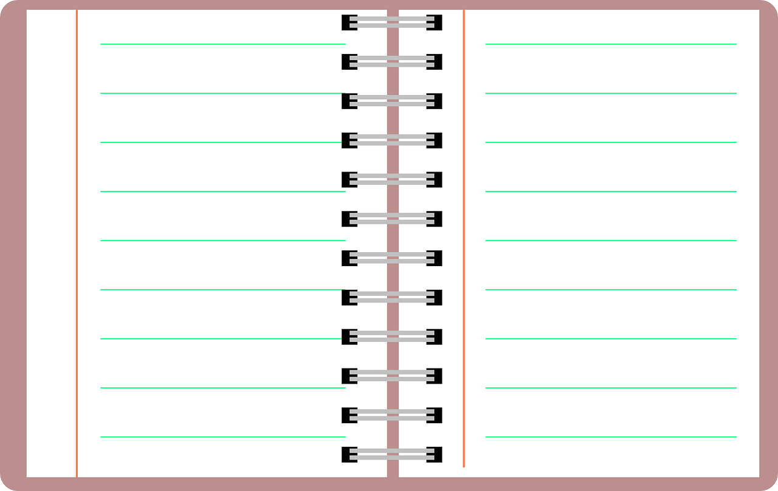
WHO ARE SLOW LEARNERS? • WAY TO SPOT THE SIGNS • TIPS FOR PARENTS/TEACHERS
TIPS FOR PARENTS/TEACHERS
5 point agenda for remedial education in a slow learner
Child’s mental maturity
4 Nature of the work plan
2 Child’s mental readiness
5 Teacher-child
relationship
3 Structure of the
teaching program
Farida Raj, Special Educator

Slide 8
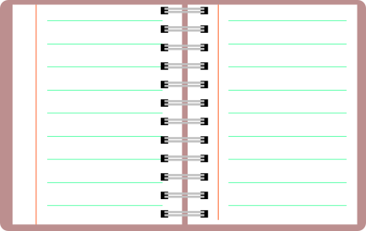
WHO ARE SLOW LEARNERS? • WAY TO SPOT THE SIGNS • TIPS FOR PARENTS/TEACHERS
TIPS FOR PARENTS/TEACHERS
5 point agenda for remedial education in a slow learner
Child’s
Mental
maturity
1
The child must be mentally matured to discriminate between letters, sounds and word shapes.
While planning activities, the teacher should bear in the mind the child’s age-appropriateness.
e.g. Slow learners aged 5-8 may require activities comparable to those of typical children aged 3-5.
Farida Raj, Special Educator

Slide 9
WHO ARE SLOW LEARNERS? • WAY TO SPOT THE SIGNS • TIPS FOR PARENTS/TEACHERS
TIPS FOR PARENTS/TEACHERS
5 point agenda for remedial education in a slow learner
Child’s
Mental
readiness
2
Formal teaching of the basic subjects should not be attempted if the child is not psychologically ready.
Failing to do so will cause the children to become frustrated bored and will exhibit less confidence.
Farida Raj, Special Educator

Slide 10
WHO ARE SLOW LEARNERS? • WAY TO SPOT THE SIGNS • TIPS FOR PARENTS/TEACHERS
TIPS FOR PARENTS/TEACHERS
5 point agenda for remedial education in a slow learner
Structure
of the
teaching
program
3
Selection of techniques to suit individual difficulties of the child can help the child learn.
Research studies show that slow learners are visually ready for reading than auditory ready. Therefore, it is important that they are taught sight vocabulary of meaningful words at the beginning of reading program and then with phonics which leads to better word recognition.
Farida Raj, Special Educator

Slide 11
WHO ARE SLOW LEARNERS? • WAY TO SPOT THE SIGNS • TIPS FOR PARENTS/TEACHERS
TIPS FOR PARENTS/TEACHERS
5 point agenda for remedial education in a slow learner
Nature of
the work
plan
4
Create a distraction free zone where the child can work quietly.
Limit working time and have several short work periods rather than a single long one.
Add variety to the academic routine. Use games, puzzles and other engaging tools during the learning process.
Work on material that is somewhat challenging but allows success. Work that is too hard or too easy may be a turn-off.
Farida Raj, Special Educator

Slide 12
WHO ARE SLOW LEARNERS? • WAY TO SPOT THE SIGNS • TIPS FOR PARENTS/TEACHERS
TIPS FOR PARENTS/TEACHERS
5 point agenda for remedial education in a slow learner
The
parent/
teacher -
child
relationship
5
A child who has experienced recurrent failure in academics may become aggressive, stubborn and may exhibit hopelessness and apathy. You as a teacher/parent must work to replace these feelings with mutual trust, optimism and enthusiasm to learn.
Make a note of the child’s weaknesses and plan activities that can help him/her overcome those challenges.
Use a lot of praise and reinforcements.
Encourage your child to talk to you.
Enquire about their day and interests.
Farida Raj, Special Educator

Slide 13
WHO ARE SLOW LEARNERS? • WAY TO SPOT THE SIGNS • TIPS FOR PARENTS/TEACHERS
Remember,
intellectual development
cannot be isolated from -
MEMORY
ATTENTION
CONCENTRATION
EMOTIONAL DEVELOPMENT
SOCIAL EXPERIENCES
Farida Raj, Special Educator

Slide 14
This content has been developed in collaboration with Remedial & Special Educator Ms.Farida Raj.
It has been adapted from her book “Breaking Through" - A Hand Book for Teachers and Parents of Children with Learning Difficulties & reproduced here with consent.
Nayi Disha Resource Centre is an online information resource platform that supports families of persons with, Specific Learning Disabilities, Intellectual & Developmental Disabilities.
Join Us on Facebook
Join Us on Twitter
Visit us at
www.nayi-disha.org
Join Us on Linkedin

