Slide 1
An Information Resource for Intellectual & Developmental Disabilities
Lets talk about child safety and protection
It's not only an expectation but a constant prayer for a parent of children with Intellectual and Developmental Disabilities (IDD) to ensure that their child is always in a safe secure environment.
It is imperative that the professionals, teachers, care givers , family members and all people caring and supporting the child are kind and sensitive towards her/him.
It's also a fact that children with special needs are at far higher risk of abuse that can be verbal, physical and/or sexual. This is high due to their inability to comprehend and communicate the dangers they encounter.
www.nayi-disha.org
Adapted from the presentation made by Ruchika Sethi Takkar

Slide 2
An Information Resource for Intellectual & Developmental Disabilities
WHY talk about child safety and protection
Individuals with IDD can be
victims of abuse because -
There are unique aspects of their disability that may hinder with self-awareness of danger
Most individuals with IDD have poor communication skills/limited verbal ability
They may have a limited sense of danger
They may have a limited sense of personal safety
They may have a limited understanding of sexuality or sexual behaviour
They may engage in self-touch that can be misconstrued as consent to be touched
www.nayi-disha.org
Adapted from the presentation made by Ruchika Sethi Takkar

Slide 3
An Information Resource for Intellectual & Developmental Disabilities
WHY talk about child safety and protection
Individuals with IDD might be at a far higher risk because of -
They may be looking for affection due to their social isolation and become easy targets of abuse
Lack of mobility
High reliance on adults for many of their needs
Of multiple people involved in their care, such as a variety of caregivers.
Their dependency on others for their intimate care such as dressing and toileting needs
They have learnt to passively obey adults, especially carers and adults in authority and hence may not recognise, resist and report any abuse
www.nayi-disha.org
Adapted from the presentation made by Ruchika Sethi Takkar

Slide 4
An Information Resource for Intellectual & Developmental Disabilities
What happens when child safety is compromised?
Any form of abuse or threat or being in a place which is not safe creates -
poor self-confidence
low self-esteem
feelings of isolation
Powerlessness
Anxiety
fear
frustration
limited assertiveness
Exaggerated behaviours/Aggression
www.nayi-disha.org
Adapted from the presentation made by Ruchika Sethi Takkar

Slide 5
An Information Resource for Intellectual & Developmental Disabilities
Preventive measures to ensure child protection
Work to create a safe zone where ever your child is
Every school, therapy centre, Clinic
Crèche, training centre, home
must be a safe zone
What is a safe zone?
A place where the child is
Comfortable
Relaxed
In no danger whatsoever
www.nayi-disha.org
Adapted from the presentation made by Ruchika Sethi Takkar

Slide 6
An Information Resource for Intellectual & Developmental Disabilities
CREATING A SAFE ZONE AT THE SCHOOL/THERAPY CENTRE
At the school premises, please ensure that:
Perimeter is secured
CCTVs are installed at critical areas of the premises
Sessions are observable at all times either through CCTV, viewing window or through physical access – OPEN DOOR POLICY MUST BE PRACTISED
During therapy no doors to be locked from inside
Parents have a right to be present during therapy and this cannot be prevented
School bus should have a lady attendant at all times
Special infrastructure, including ramps, railings toilets for better accessibility
Certain therapy procedures involving touch of the body may trigger result in heightened sexual awareness in the adolescent (e.g. exercise ball).
It is suggested that keeping the child’s individuality
(and lack of self-awareness) in mind all such protocols
must be reviewed before practicing on the child.
www.nayi-disha.org
Adapted from the presentation made by Ruchika Sethi Takkar

Slide 7
An Information Resource for Intellectual & Developmental Disabilities
OPEN DOOR POLICY MUST BE ENCOURAGED
Work to create a safe zone where ever your child is present
Every school, therapy centre, Clinic
Crèche, training centre, home
must have an open door policy
What does open door policy in a place mean?
It means a place where the child is present must remain open at all times.
NO CLOSED DOORS
A place where parents have the right to be
present for the sessions.
www.nayi-disha.org
Adapted from the presentation made by Ruchika Sethi Takkar

Slide 8
An Information Resource for Intellectual & Developmental Disabilities
Code of conduct guidelines
Insist on a child protection policy at every school
Policy must include a safety plan which specifies procedures followed by the Centre to prevent and handle emergencies such as accidents or medical emergencies
Background check and verification of staff
Lay down code of conduct for all teaching staff, support staff, helpers or ayahs. They must be aware of the legal implications and strict punishments in case of any violation.
Staff is trained on how to help children without compromising on their sense of dignity. Training on what is acceptable and what is not.
No filming of the child without permission of parent
Most cases of abuse happen when the child is not toilet trained. Insist on the toilet protocol (process of taking to toilet, handling, undressing, dressing, cleaning etc)
www.nayi-disha.org
Adapted from the presentation made by Ruchika Sethi Takkar

Slide 9
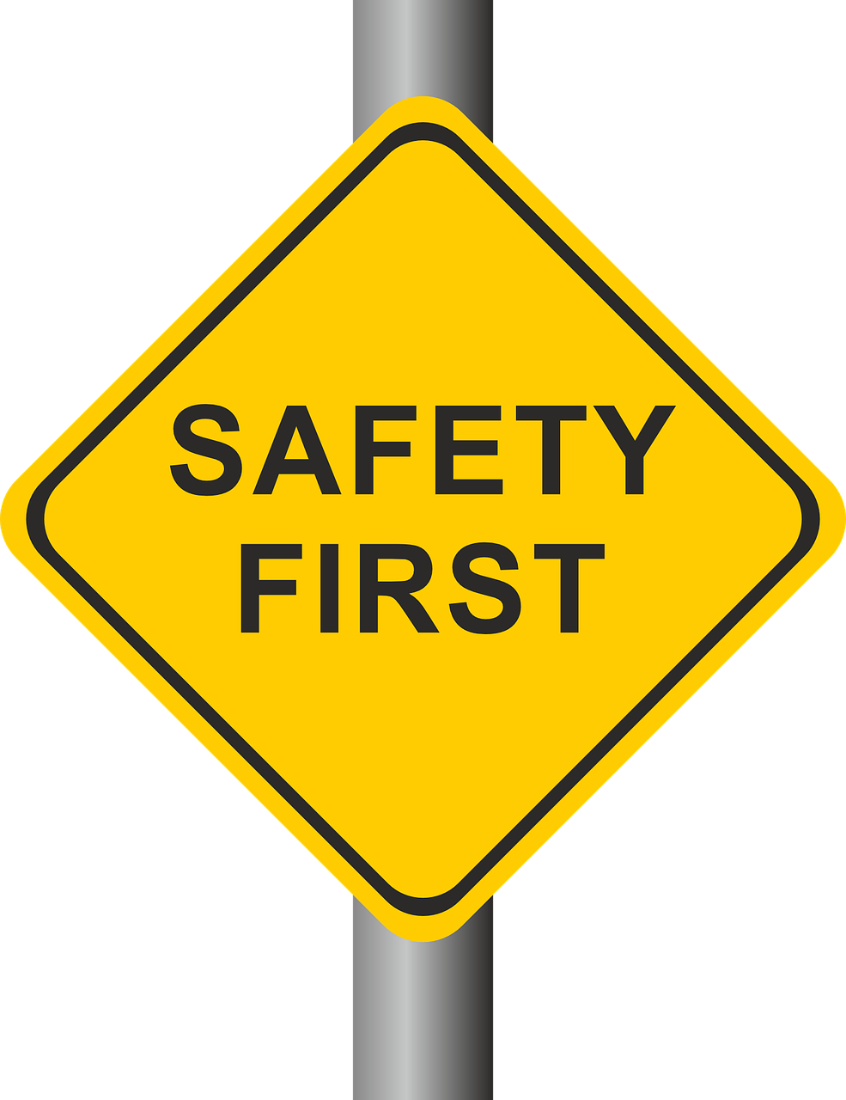
An Information Resource for Intellectual & Developmental Disabilities
Risk safety at school
Measures to reduce physical hazards that risk safety of children
Ensure safe glass installations
Toys and sensory tools need to be clean, repaired and rid of any sharp edges
The mattress and foam pads should be clean and regularly washed
If the centre Is in basement, there should be proper ventilation
Dust mites and asthma triggers should be minimal
Ensure regular cleaning of the premises and toilets
www.nayi-disha.org
Adapted from the presentation made by Ruchika Sethi Takkar

Slide 10
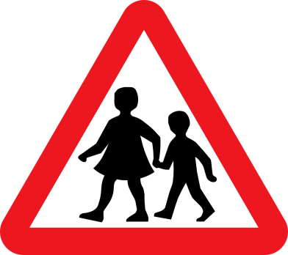
An Information Resource for Intellectual & Developmental Disabilities
Create awareness of child safety
Create awareness among all personnel with regard to child safety and
simple preventive measures
Conflict resolution
between child and therapist
Regular sessions with the children about safe and unsafe touch
Anti-bullying
sessions
www.nayi-disha.org
Adapted from the presentation made by Ruchika Sethi Takkar

Slide 11
An Information Resource for Intellectual & Developmental Disabilities
Parents are the change agents
All parents at all therapy centers/ schools must insist on promoting
child safety and
protection guidelines.
Change will happen if the parent community come together and demands change.
INSIST ON
YOUR RIGHTS
AS A PARENT
www.nayi-disha.org
Adapted from the presentation made by Ruchika Sethi Takkar

Slide 12
An Information Resource for Intellectual & Developmental Disabilities
CONTENT CREDITS
Adapted from the presentation made by Ruchika Sethi Takkar
to Gurugram Police in 2014.
She places emphasis on an Integrated Child Protection Policy, and a Stay-Safe Plan , which parents definitely need to adopt.
INSIST ON
YOUR RIGHTS
AS A PARENT
www.nayi-disha.org

